Slide 2
Computational approaches for the therapeutic target discovery to ame-liorate muscle wasting during aging and disease
Msc Karen Guerrero Vazquez
Dr. Katarzyna Whysall
Dr. Pilib O Broin

Slide 3





Notes:
Our lives are full of changes, we grow up getting stronger and smarter, but at certain point, we start to call it growing older. And one of the most striking effects of aging is the loss of muscle mass, strength and functionality

Slide 4
~3 – 8 %
Loss of muscle mass per decade
Brocklehurst, 1976
Notes:
. From the time you are born to around the time you turn 30, your muscles grow larger and stronger. But at some point in your 30s, you start to lose muscle mass and function. Is expected a loss of 3 to 8% of muscle mass per decade after age 30, and this rate of decline is even higher after the age of 60. Sarcopenia is associated with detrimental clinical outcomes, such as a reduced quality of life, frailty, an increased risk of falls, fractures, hospitalization, and mortality.
4

Slide 5
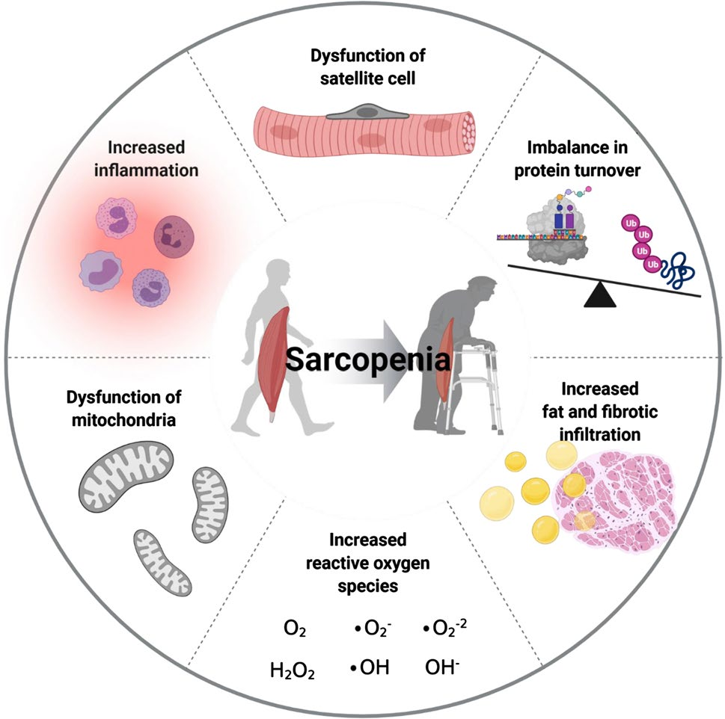
Notes:
Sarcopenia refers to the gradual loss of skeletal uscle mass and function along with aging and is a social burden due to growing healthcare cost associated with a super-aging society. Several factors, including chronic inflammation, increased reactive oxidative species, increased fibrosis of muscle, and increased loss of motor neurons, have been reported to contribute to development of sarcopenia

Slide 6

MicroRNA (miRNAs)

Slide 7

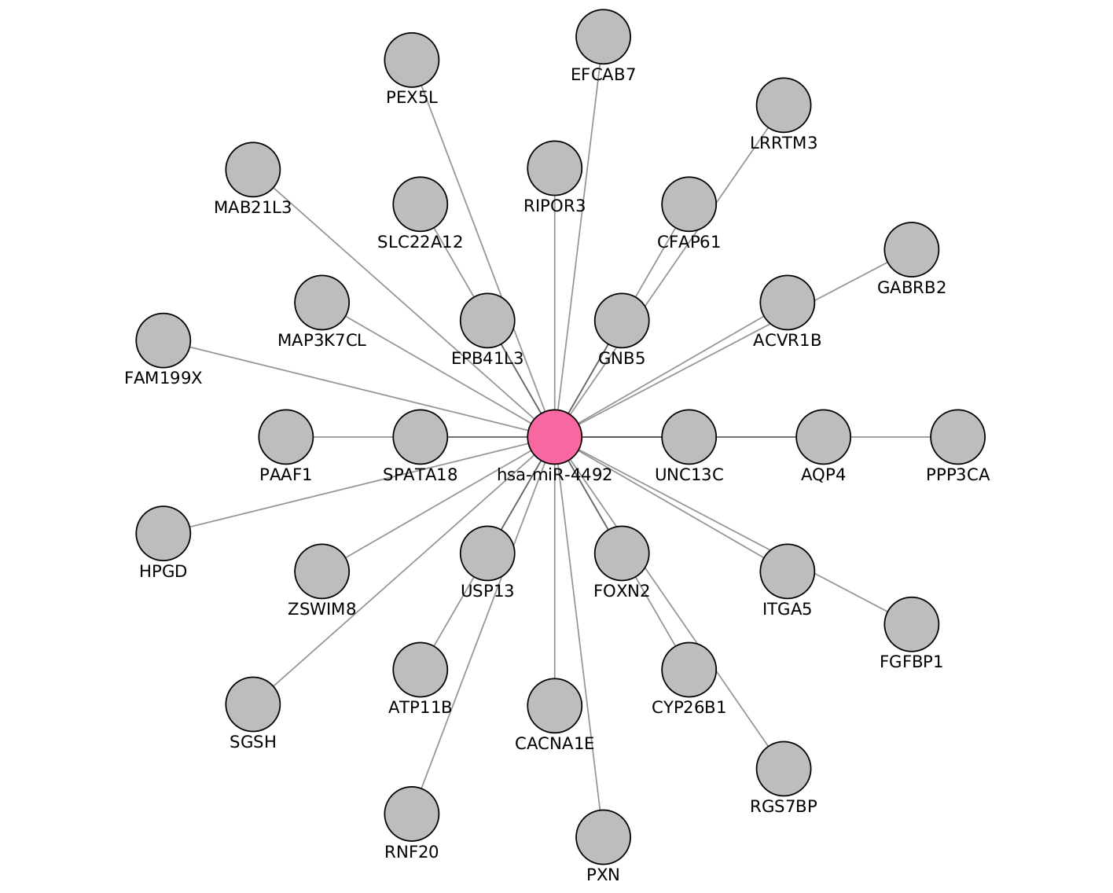
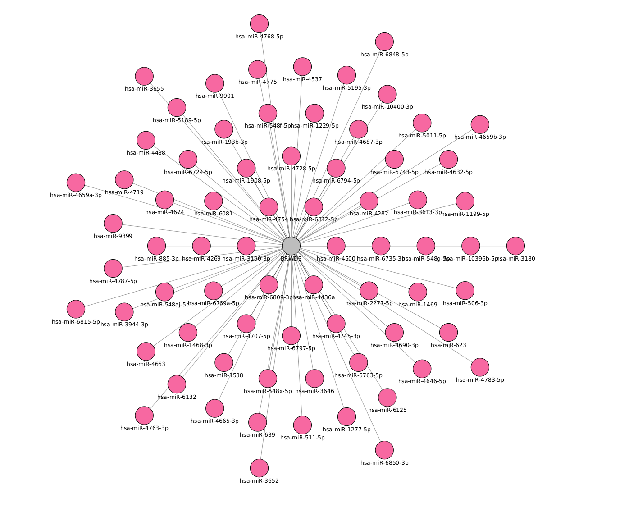
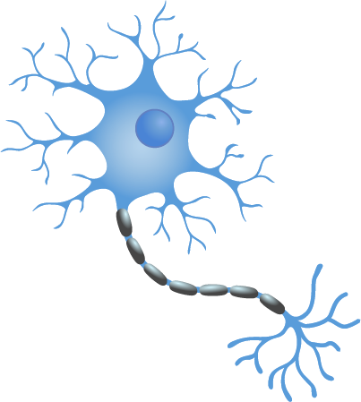
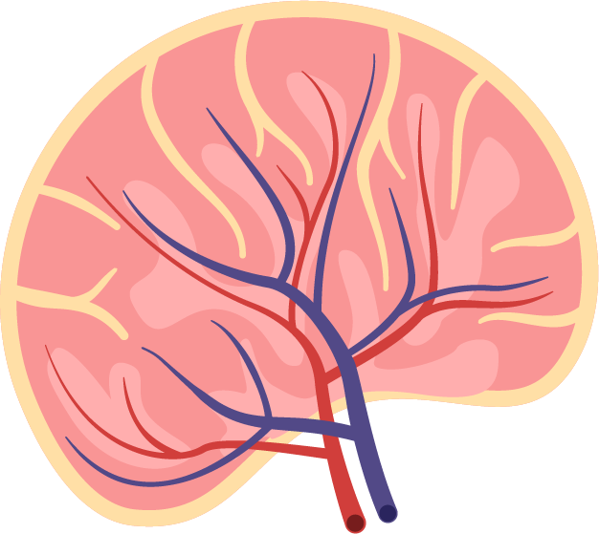
MicroRNA (miRNAs)
Notes:
miRNAs are often ubiquitously expressed, have overlapping functions and can regulate multiple genes. Also, not all miRNAs are functionally relevant in a given cell type.

Slide 8
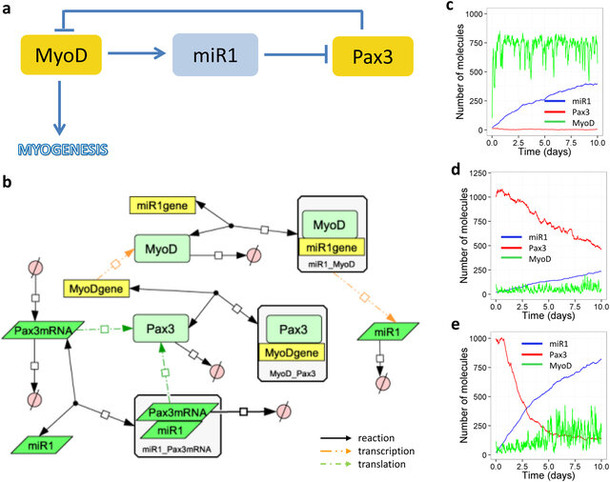
Objective
Create independent models and a common model of miR:target interactions in muscle loss during aging and critical illness based on differentially expressed (DE) miRs and genes
Identification or shortlisted microRNAs as candidates for therapeutics targets against sarcopenia.
Carole J. Proctor & Katarzyna Goljanek-Whysall, 2017, Using computer simulation models to investigate the most promising microRNAs to improve muscle regeneration during ageing
Notes:
miRNAs are often ubiquitously expressed, have overlapping functions and can regulate multiple genes. Also, not all miRNAs are functionally relevant in a given cell type.

Slide 9






Tools to analyze miRNAs

Slide 10
Tools to analyze miRNAs

Slide 11



Tools to analyze miRNAs

Slide 12
Tools to analyze miRNAs

Slide 13
Tools to analyze miRNAs

Slide 14
Tools to analyze miRNAs

Slide 15
Tools to analyze miRNAs

Slide 16
Tools to analyze miRNAs

Slide 17
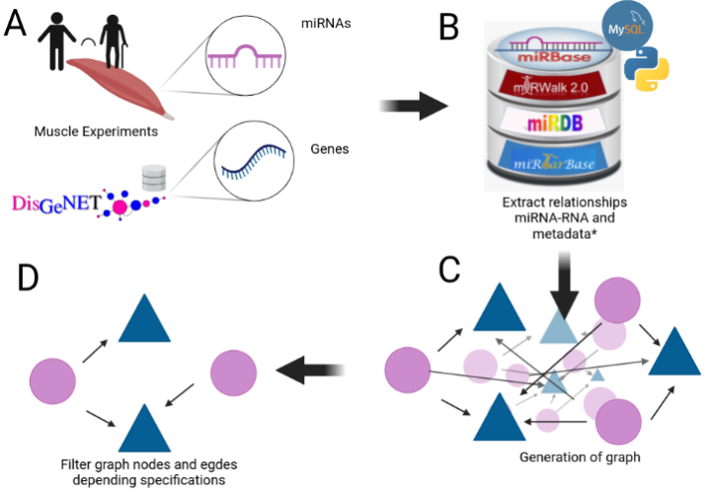
Notes:
17

Slide 18
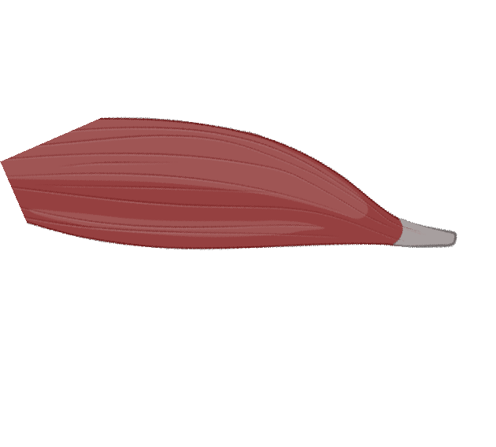

How to start

Slide 19
My Experiments
Target | Type | N. Experiments | Healthy | Non healthy
mRNA | RNAseq | 3 | 3 | 0
 | MicroArray | 4 | 2 | 2
miRNA | MicroArray | 2 | 2 | 0
 | miRSeq | 1 | 0 | 1

Slide 20
Expression during age
max
Expression
min
20
25
30
35
40
45
50
55
60
65
70
75
80
Age
Figure 2: change of gene expression by age

Slide 21
Expression during age
max
Expression
min
20
25
30
35
40
45
50
55
60
65
70
75
80
Age
Figure 2: change of gene expression by age

Slide 22
Expression during age
Middle age
Old
Young
Y
<35>
MA
<65>
O
Figure 2: change of gene expression by age

Slide 23
Experiments
GEO number | Samples | Min Age | Max Age | Reference
GSE152558 | 5 | 41 | 85 | Tharakan, R., Ubaida-Mohien, C., Piao, Y., Gorospe, M., & Ferrucci, L. (2021).
GSE164471 | 53 | 34 | 80 | Tumasian III, R. A., Harish, A., Kundu, G., Yang, J. H., Ubaida-Mohien, C., Gonzalez-Freire, M., ... & Ferrucci, L. (2021).
GSE157585 | 136 | 19 | >65 | Kulkarni, A. S., Peck, B. D., Walton, R. G., Kern, P. A., Mar, J. C., Windham, S. T., ... & Peterson, C. A. (2020).
GSE87105 | 16 | 30 | 78 | Mercken, E. M., Capri, M., Carboneau, B. A., Conte, M., Heidler, J., Santoro, A., ... & de Cabo, R. (2017)..
GSE23527 | 36 | 29 | 76 | Drummond, M. J., McCarthy, J. J., Sinha, M., Spratt, H. M., Volpi, E., Esser, K. A., & Rasmussen, B. B. (2011)

Slide 24
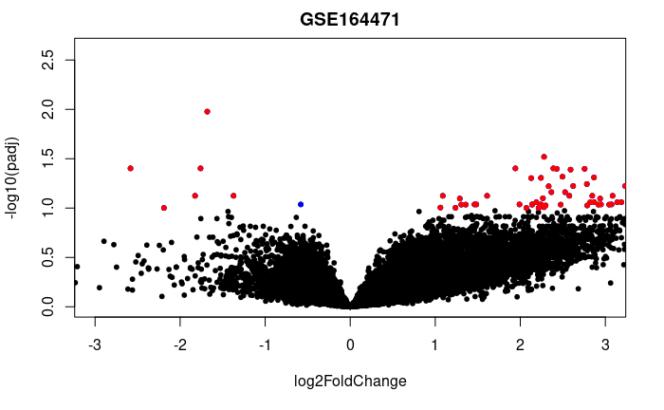

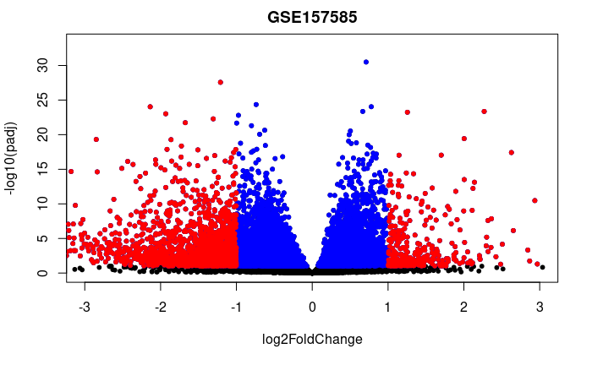
GSE152558
GSE164471
GSE157585
GSE87105
GSE23527

Slide 25
Experiment | Evaluation | Regulation | Genes
GSE152558 | MO | UP | 8
GSE152558 | MO | Down | 9
GSE157585 | YO | UP | 9
GSE157585 | YO | Down | 73
GSE164471 | YO | UP | 5
GSE164471 | YM | UP | 2
GSE164471 | MO | UP | 6
GSE164471 | YO | Down | 8
GSE164471 | YM | Down | 2
GSE164471 | MO | Down | 11
GSE23527 | YO | Up | 1
GSE23527 | YO | Down | 5
GSE875105 | OY | Down | 88
GSE875105 | MO | Up | 6
GSE875105 | OY | Up | 18
Notes:
We mentioned that aging have a lot of factors attached to it, in the specific case of Sarcopenia we can include chronic inflammation, increased reactive oxidative species, and increased fibrosis of muscle, among others have been reported to contribute to development of sarcopenia
25

Slide 26
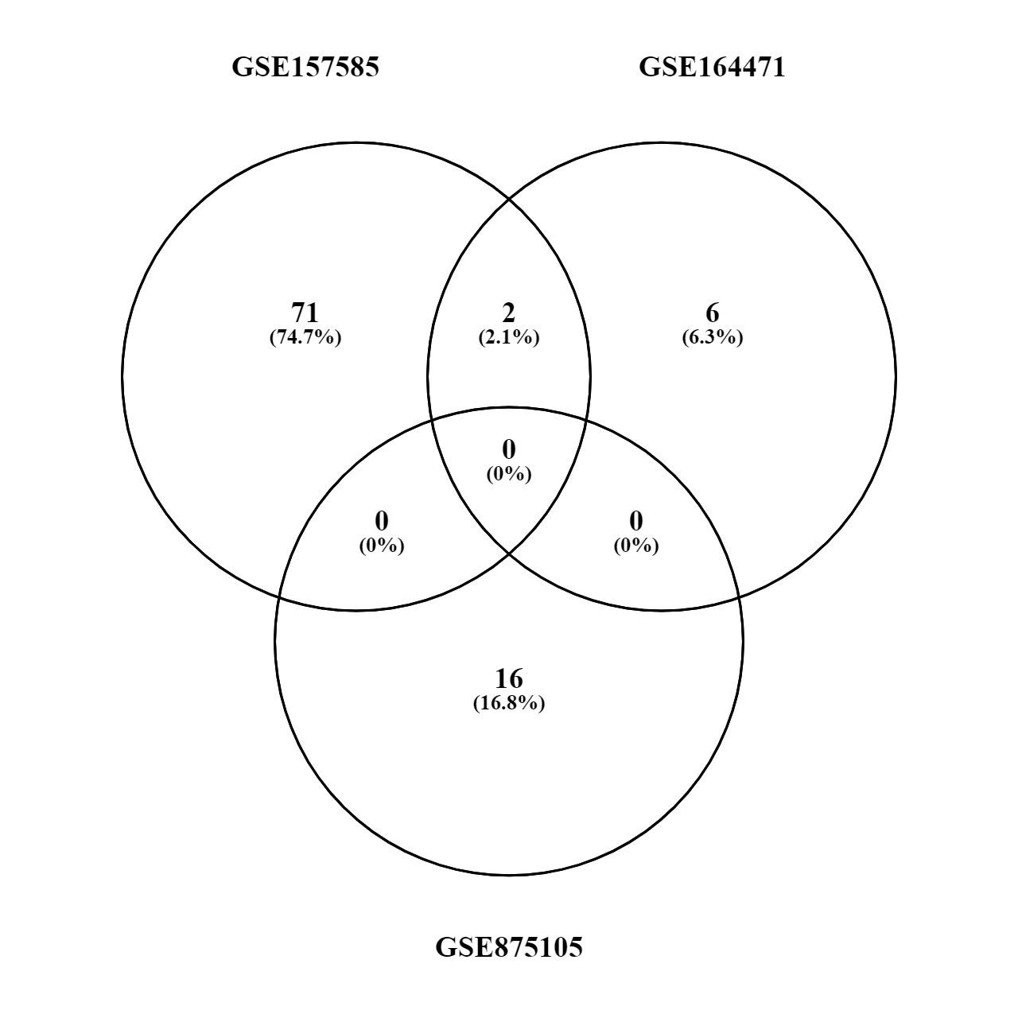
Old vs Young (up or down)
MYH8
HCN1

Slide 27

Old vs Young (up or down)

Slide 28



Slide 29
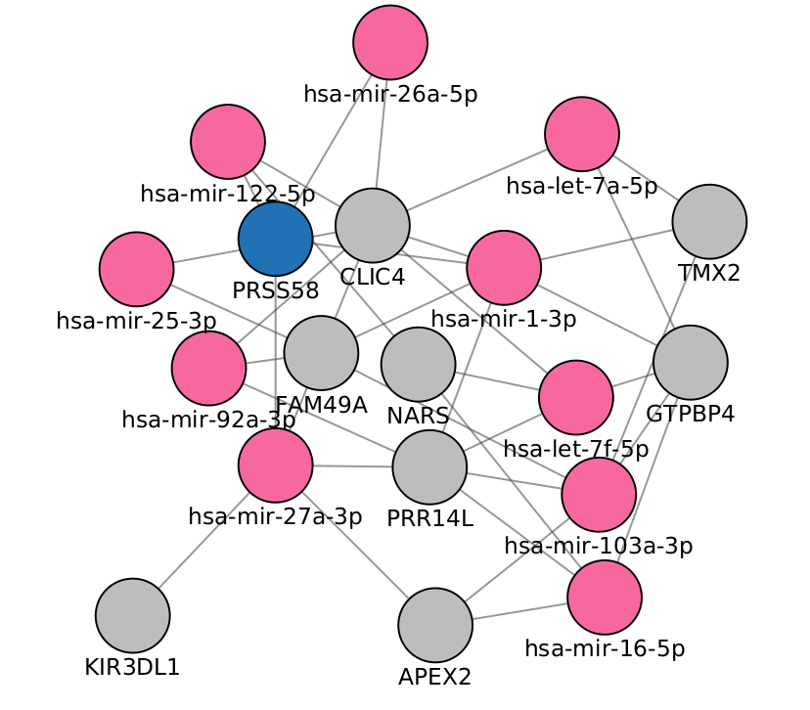

Slide 30



446 genes
2k miRNAs
3.5 edges
5 miRNAs
146 genes
163 edges
20 genes
446 genes
1.2k edges

Slide 31
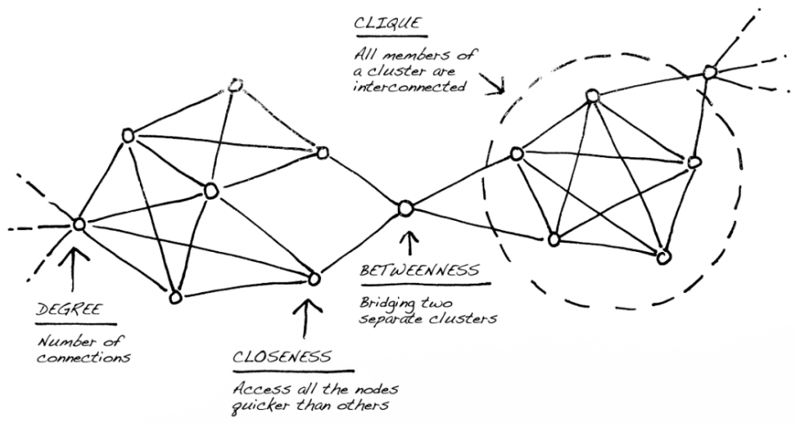

Slide 32
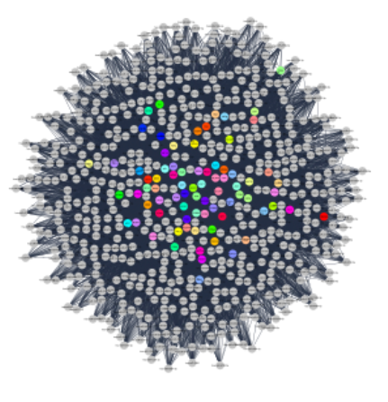

Slide 33
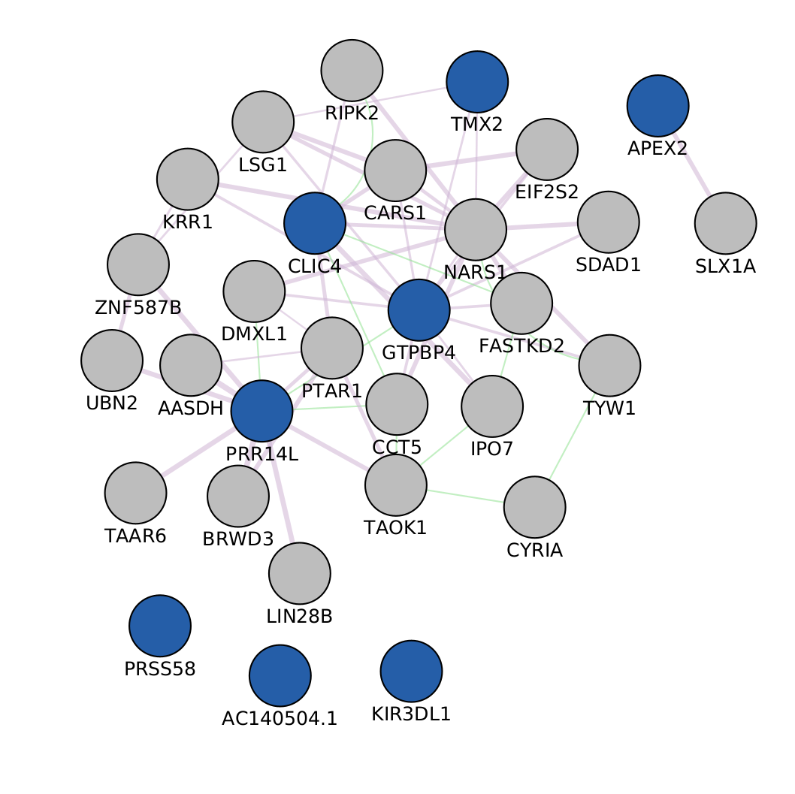

Slide 34
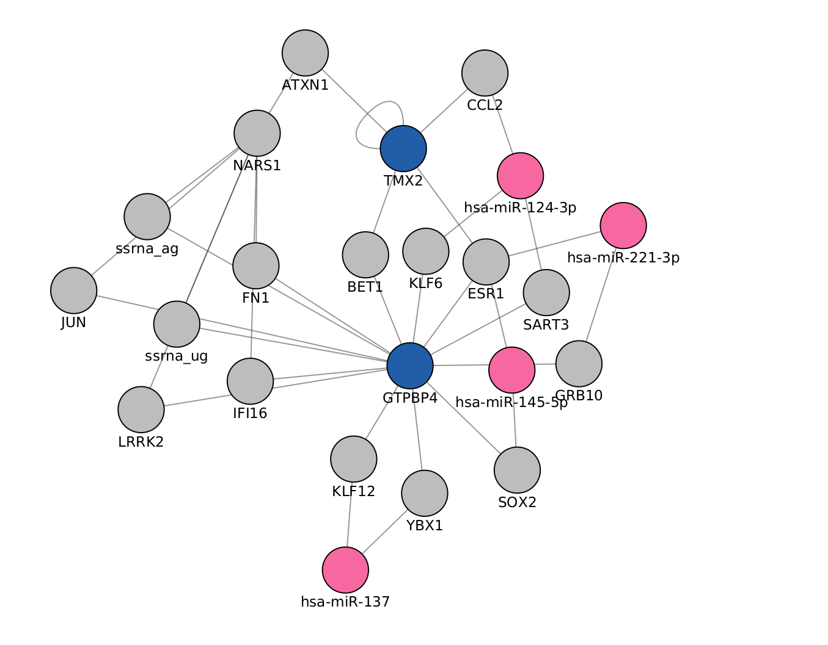

Slide 35
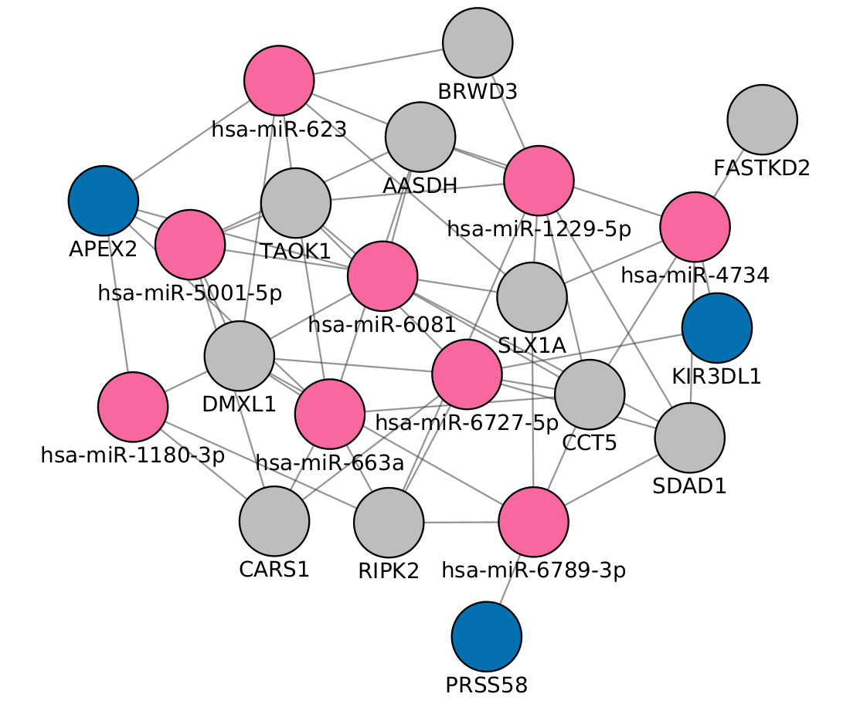

Slide 36


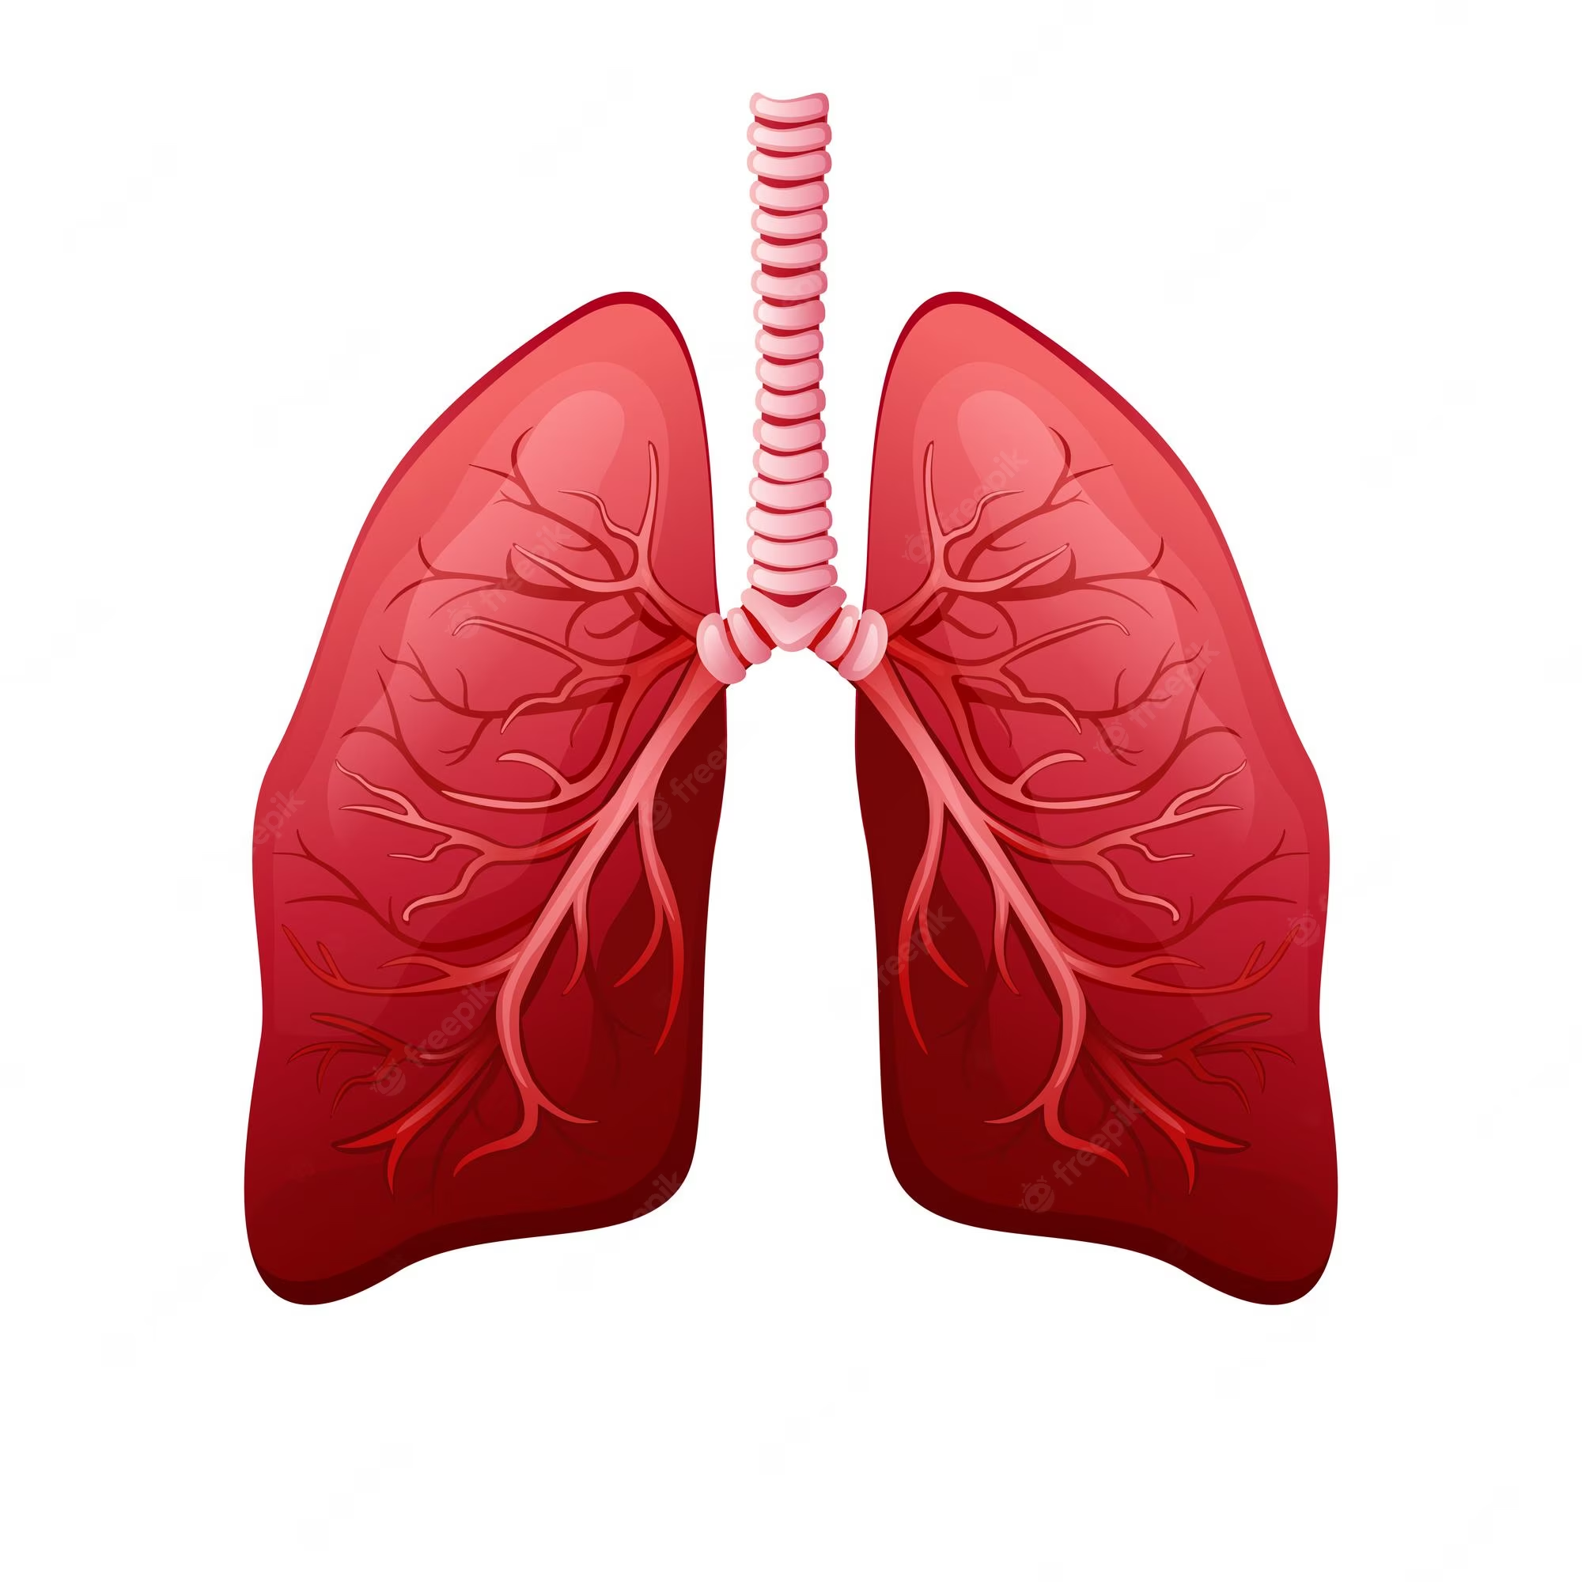
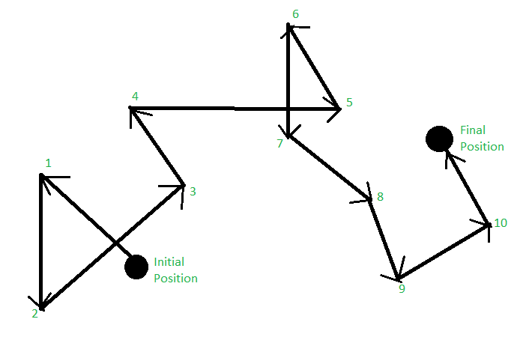
AUPRC

Slide 37
50% IntAct + Closeness centrality
20% mirNet
23%
GeneMania + PageRank
Differentially expressed?

Slide 38


Slide 39
Questions?
?
Notes:
39

Slide 40
Thank You

Slide 41
Acknowledgements
This presentation has emanated from research conducted with the financial support of Science Foundation Ireland under Grant number [18/CRT/6214 ]

Slide 42
Next steps
Clean up the evaluation system
Define criteria for microRNA and gene selection
Select the microRNAs to send to the lab
Re run different configurations to find the best output
Work on the database

